Slide 1


Haplotype Tagging – Data and Applications
Zemin Ning
The Wellcome Trust Sanger Institute
UK

Slide 2
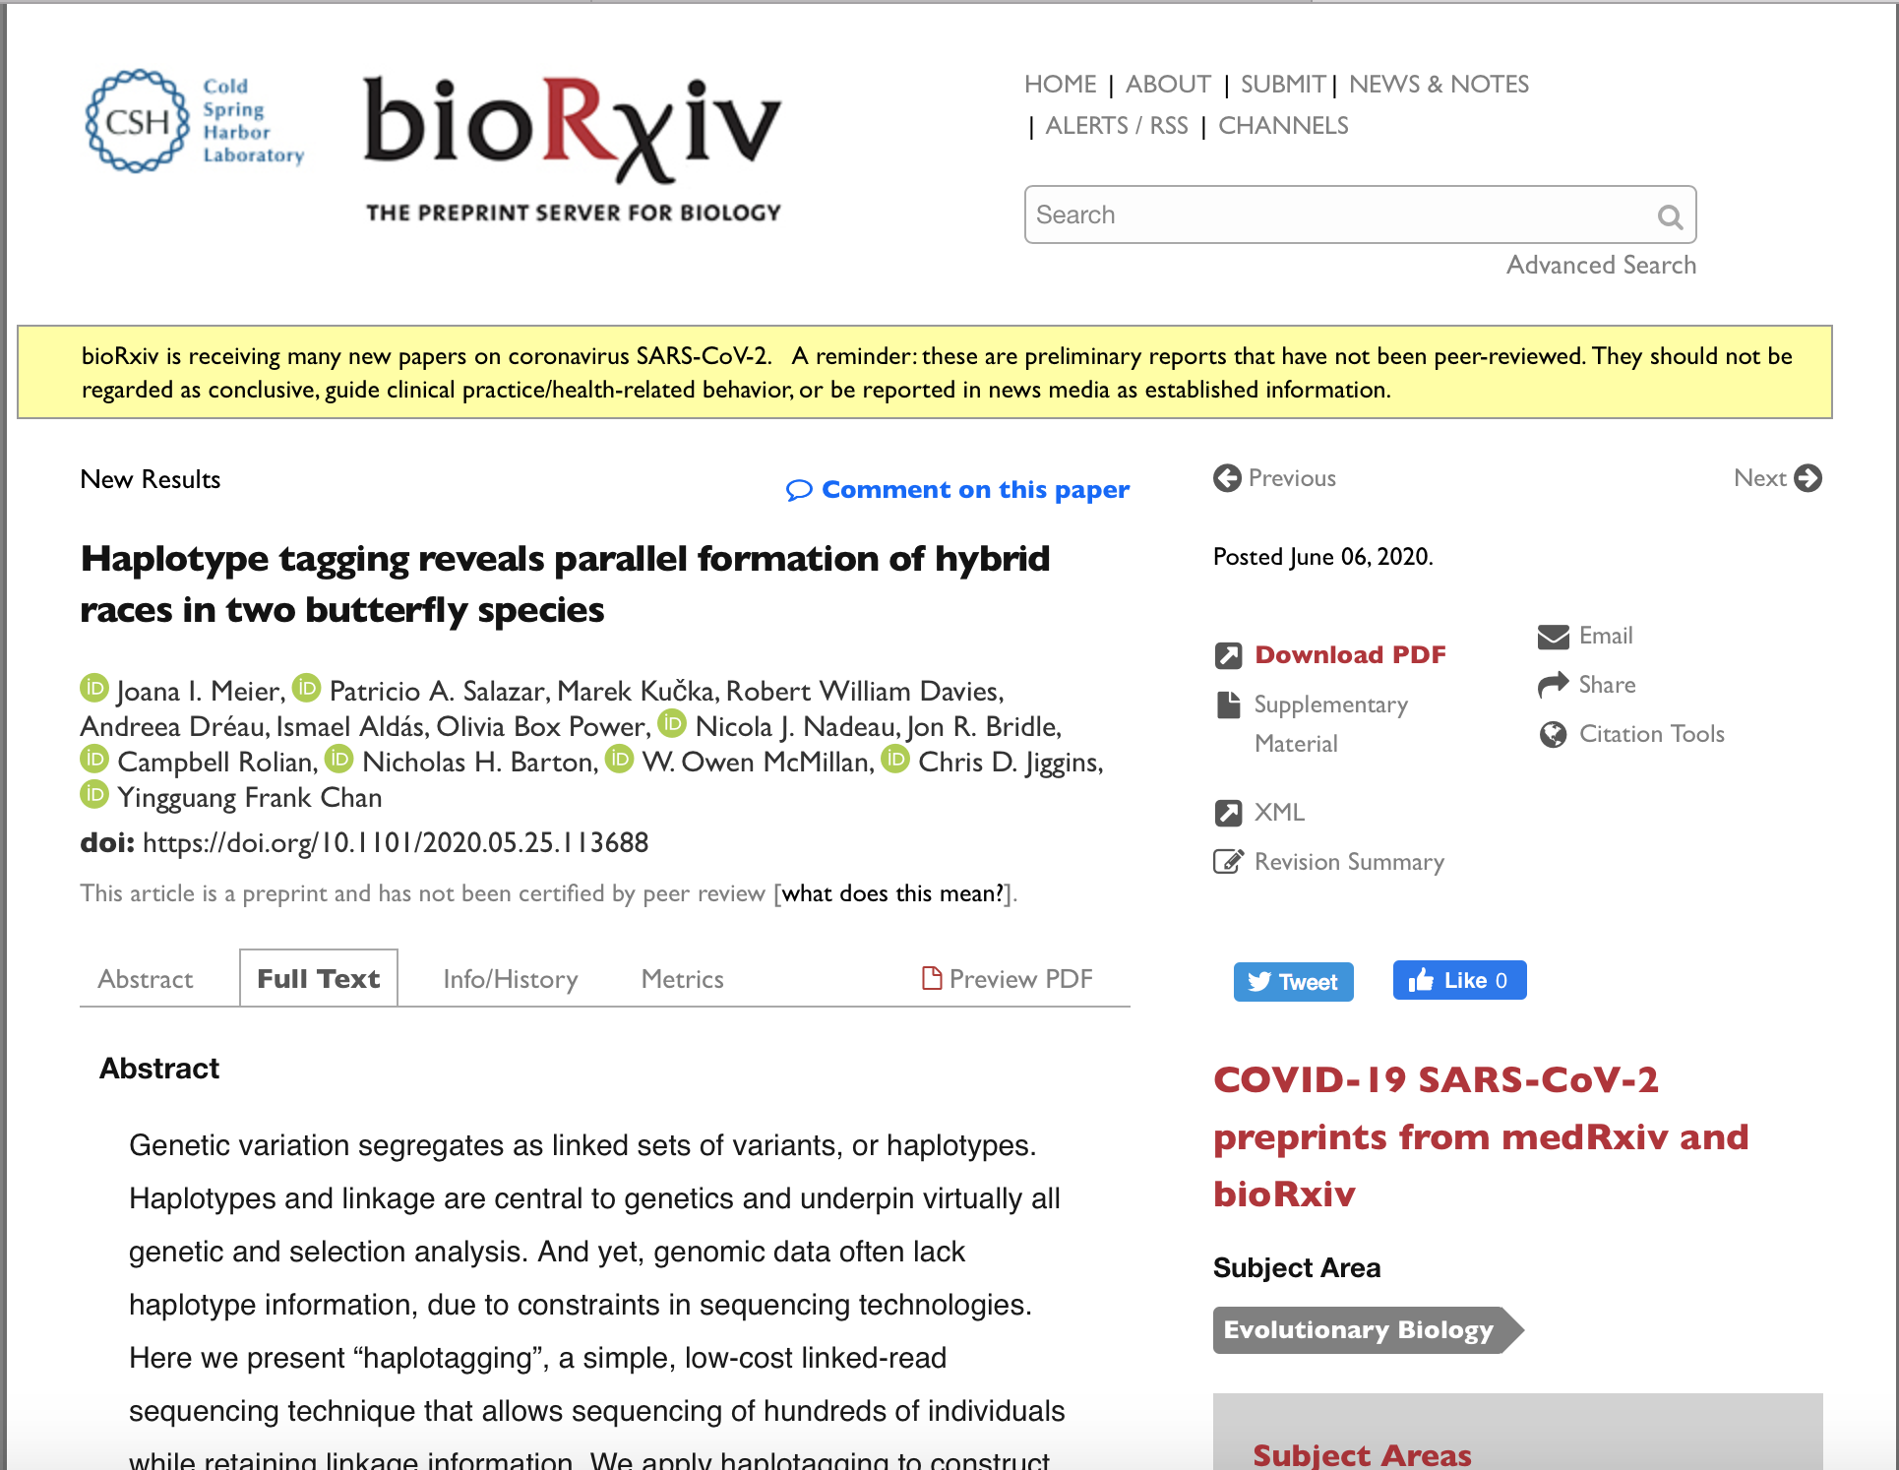

Slide 3

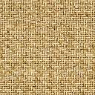
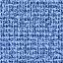
Barcodes in Haplotype Tagging
A01
…
A96
B01
…
B96
C01
…
C96
D01
…
D96
12 Libraries
each sample
96
96
96
96
96*96*96*96
=
84,934,656
12*96*96*96
=
10,616,832

Slide 4
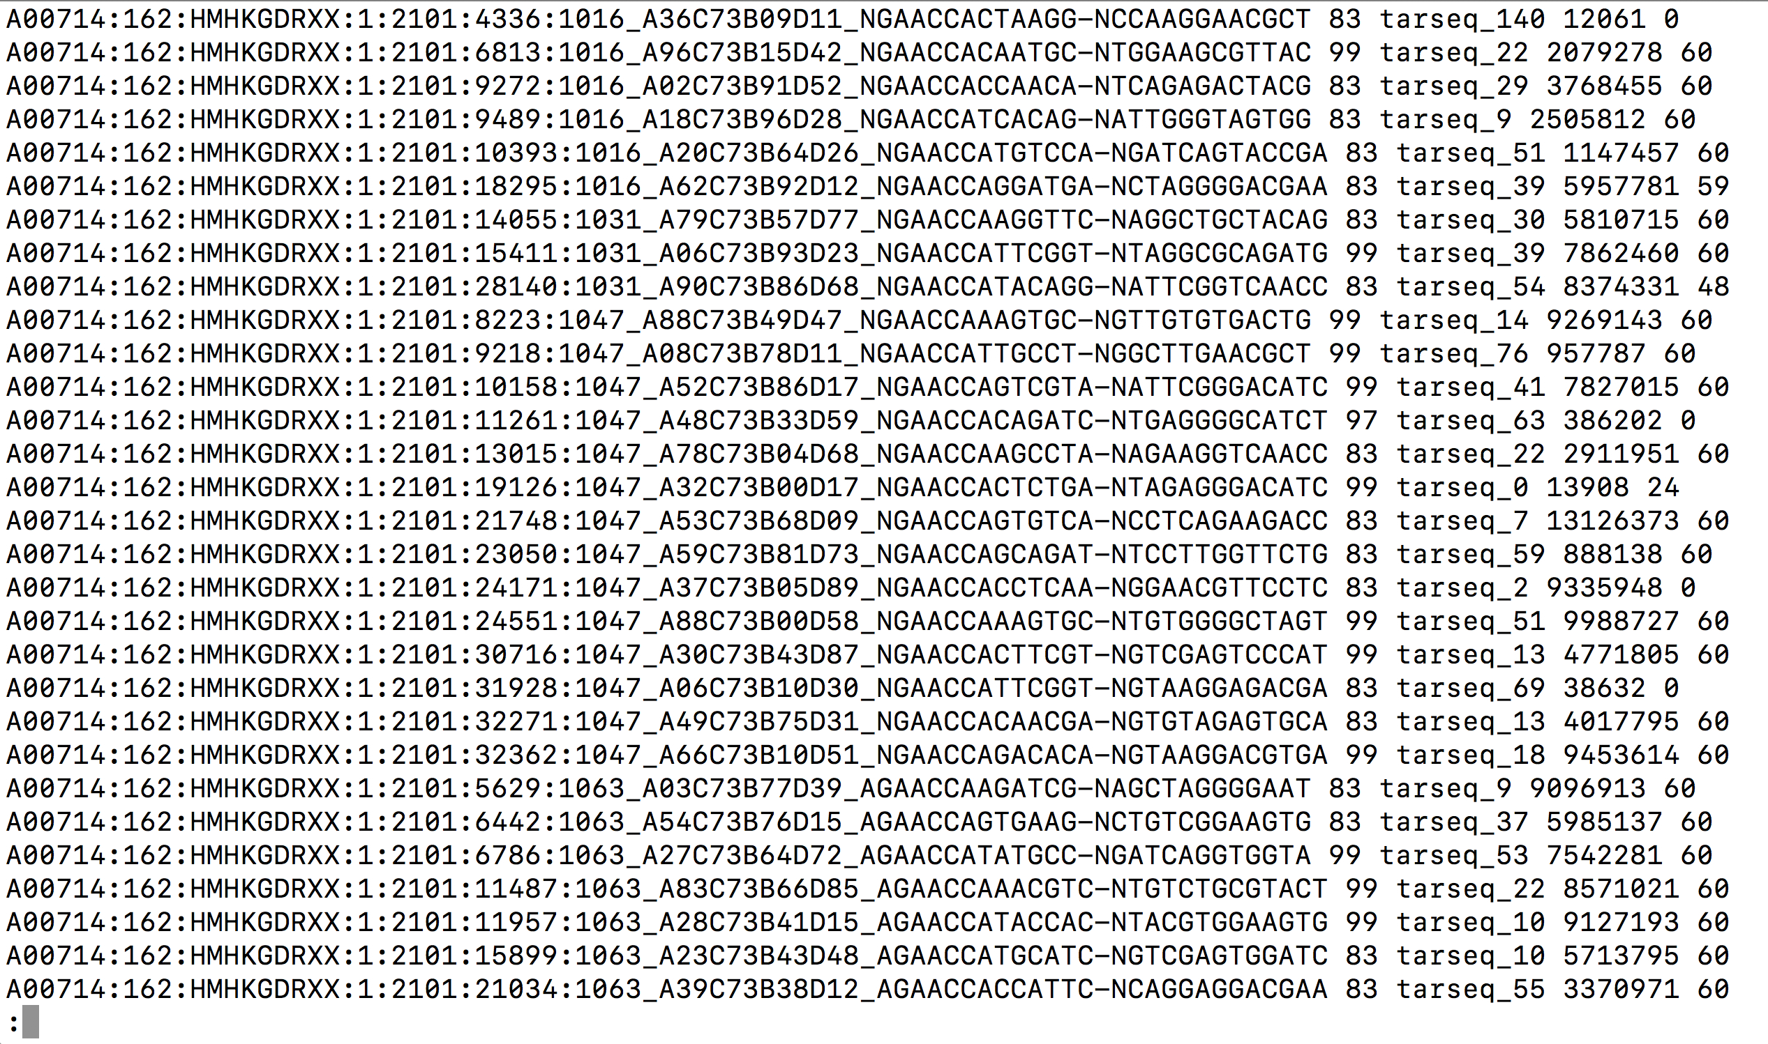
Barcodes in Haplotype Tagging
BX
BC

Slide 5
Barcodes in Haplotype Tagging
@A00971:140:H3MVLDRXY:2:2135:6714:28213_A83C16B91D95_TACTCGAAACGTC-GTCAGAGCGGTTA
GGATGAAATGGACAACTTCCTAGACAGATACCAGGTACCAAAGCTAAATCAGGATCAGATTCATGGACTAAAAGTCCCATTTCCCCTAAAGAAATAGAGGCAGTCATCAATAGTCTCCCAACCAAAAAAAAAAAAAAAAAAAAAAAAAAA
A83C16B91D95_TACTCGAAACGTC-GTCAGAGCGGTTA
A83C16B91D95
BX
TACTCGAACGTCTCTGACTAACCG
BC

Slide 6
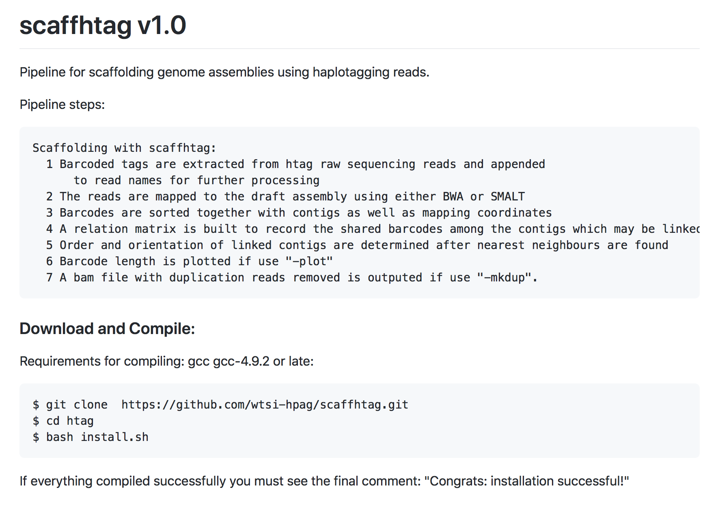

Slide 7
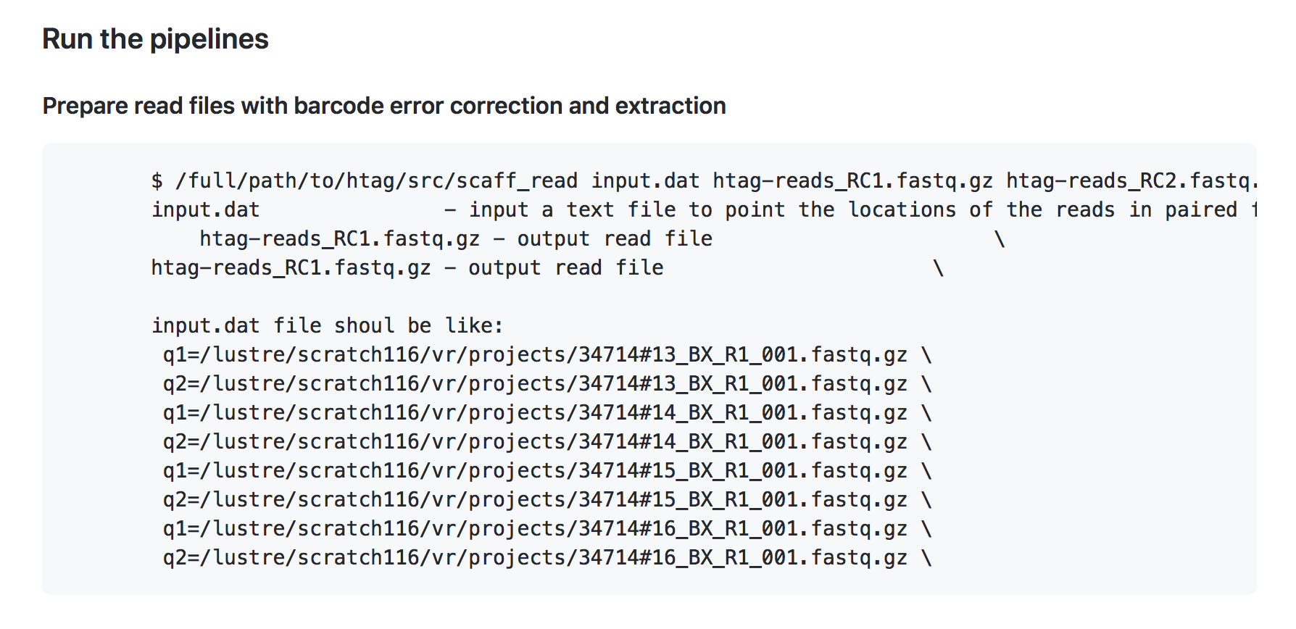

Slide 8
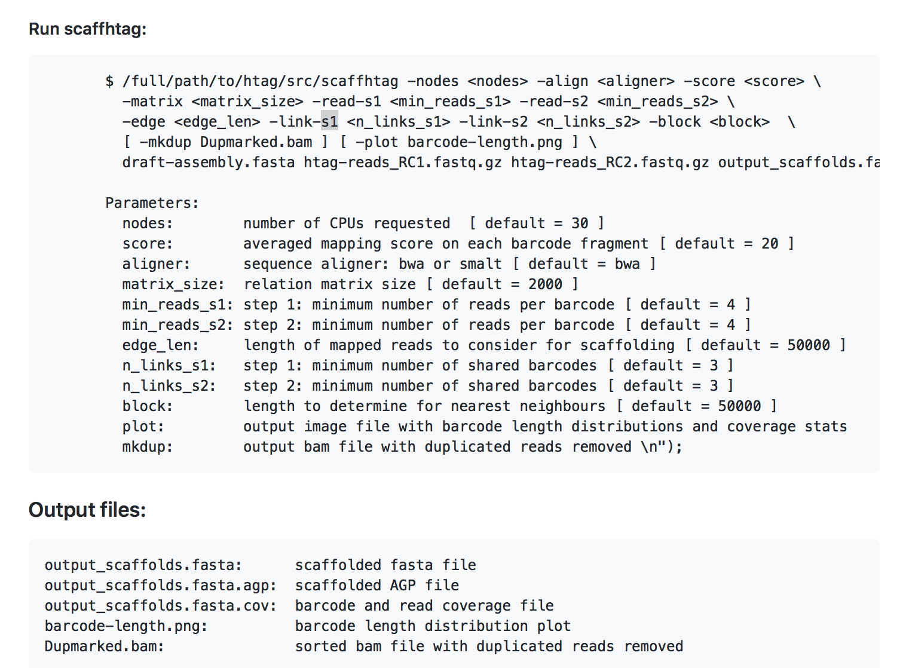
/nfs/users/nfs_z/zn1/src/scaffhtag/src/scaffhtag -nodes 54 -matrix 2000 -reads 4 -score 20 -link 3 –mkdup Dupmarked.bam -plot barcode_length.png GRCm39-chr.fasta htag-reads_RC1.fastq.gz htag-reads_RC2.fastq.gz genome-scaffhap.fasta > try.out

Slide 9
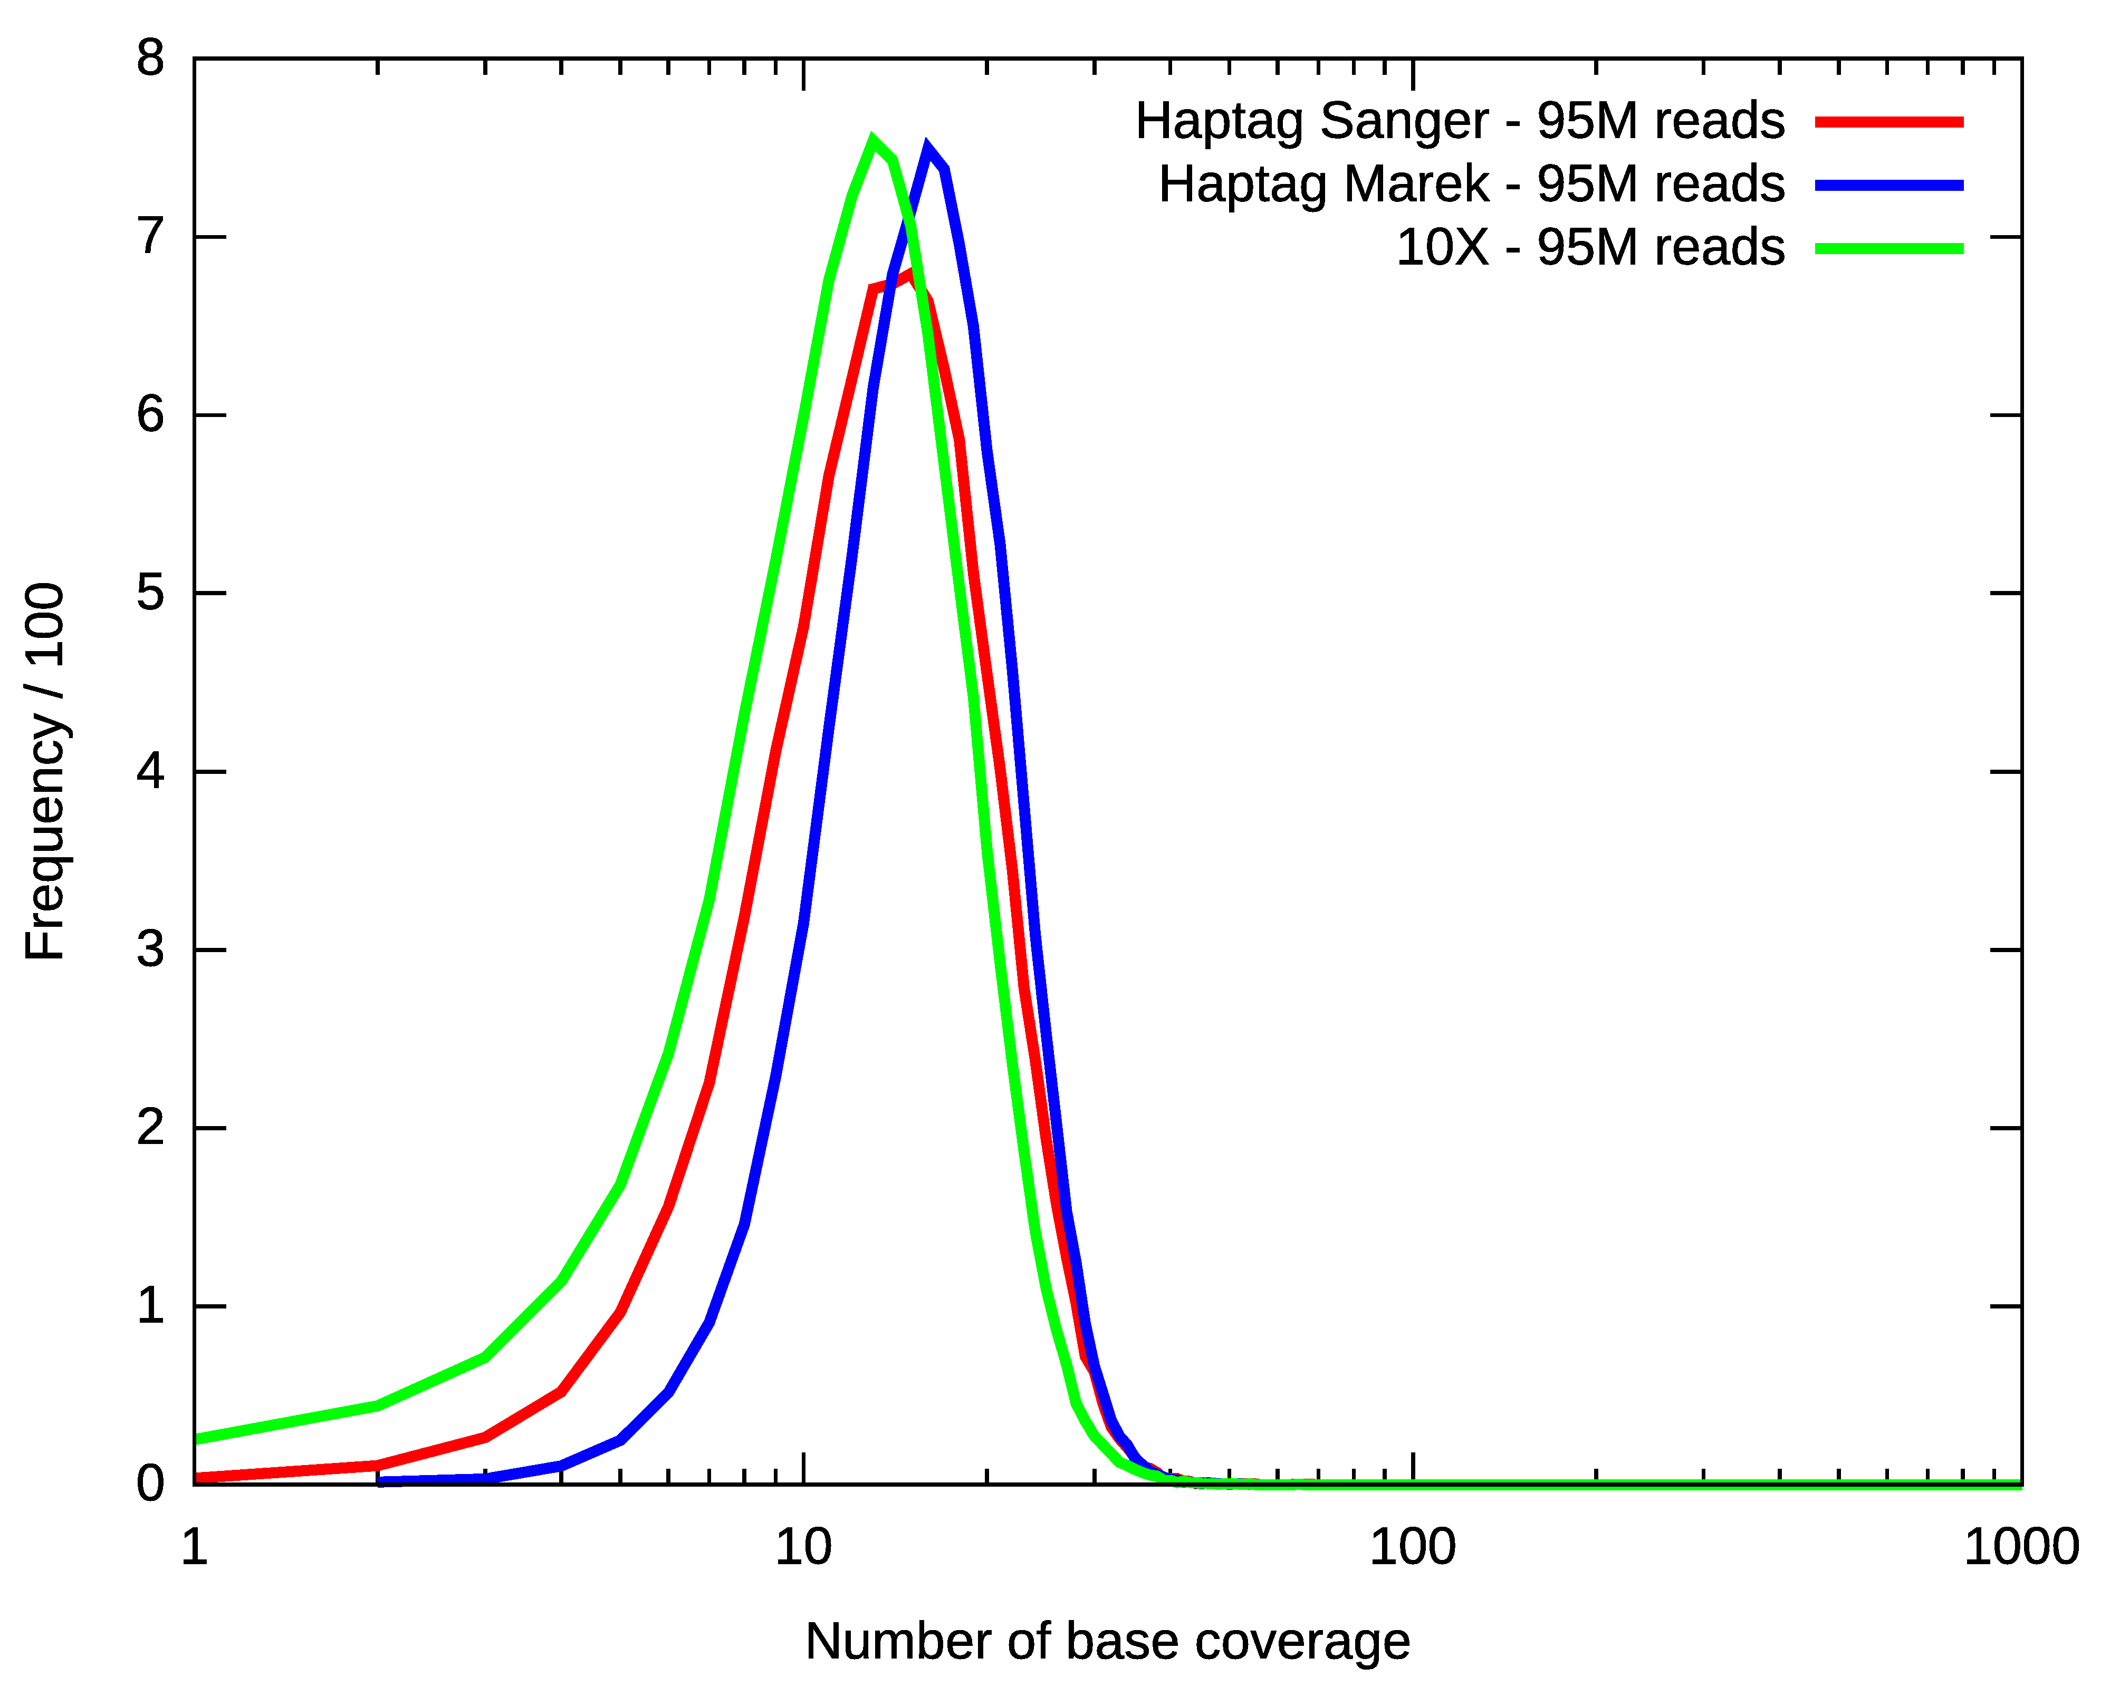
Base Coverage

Slide 10
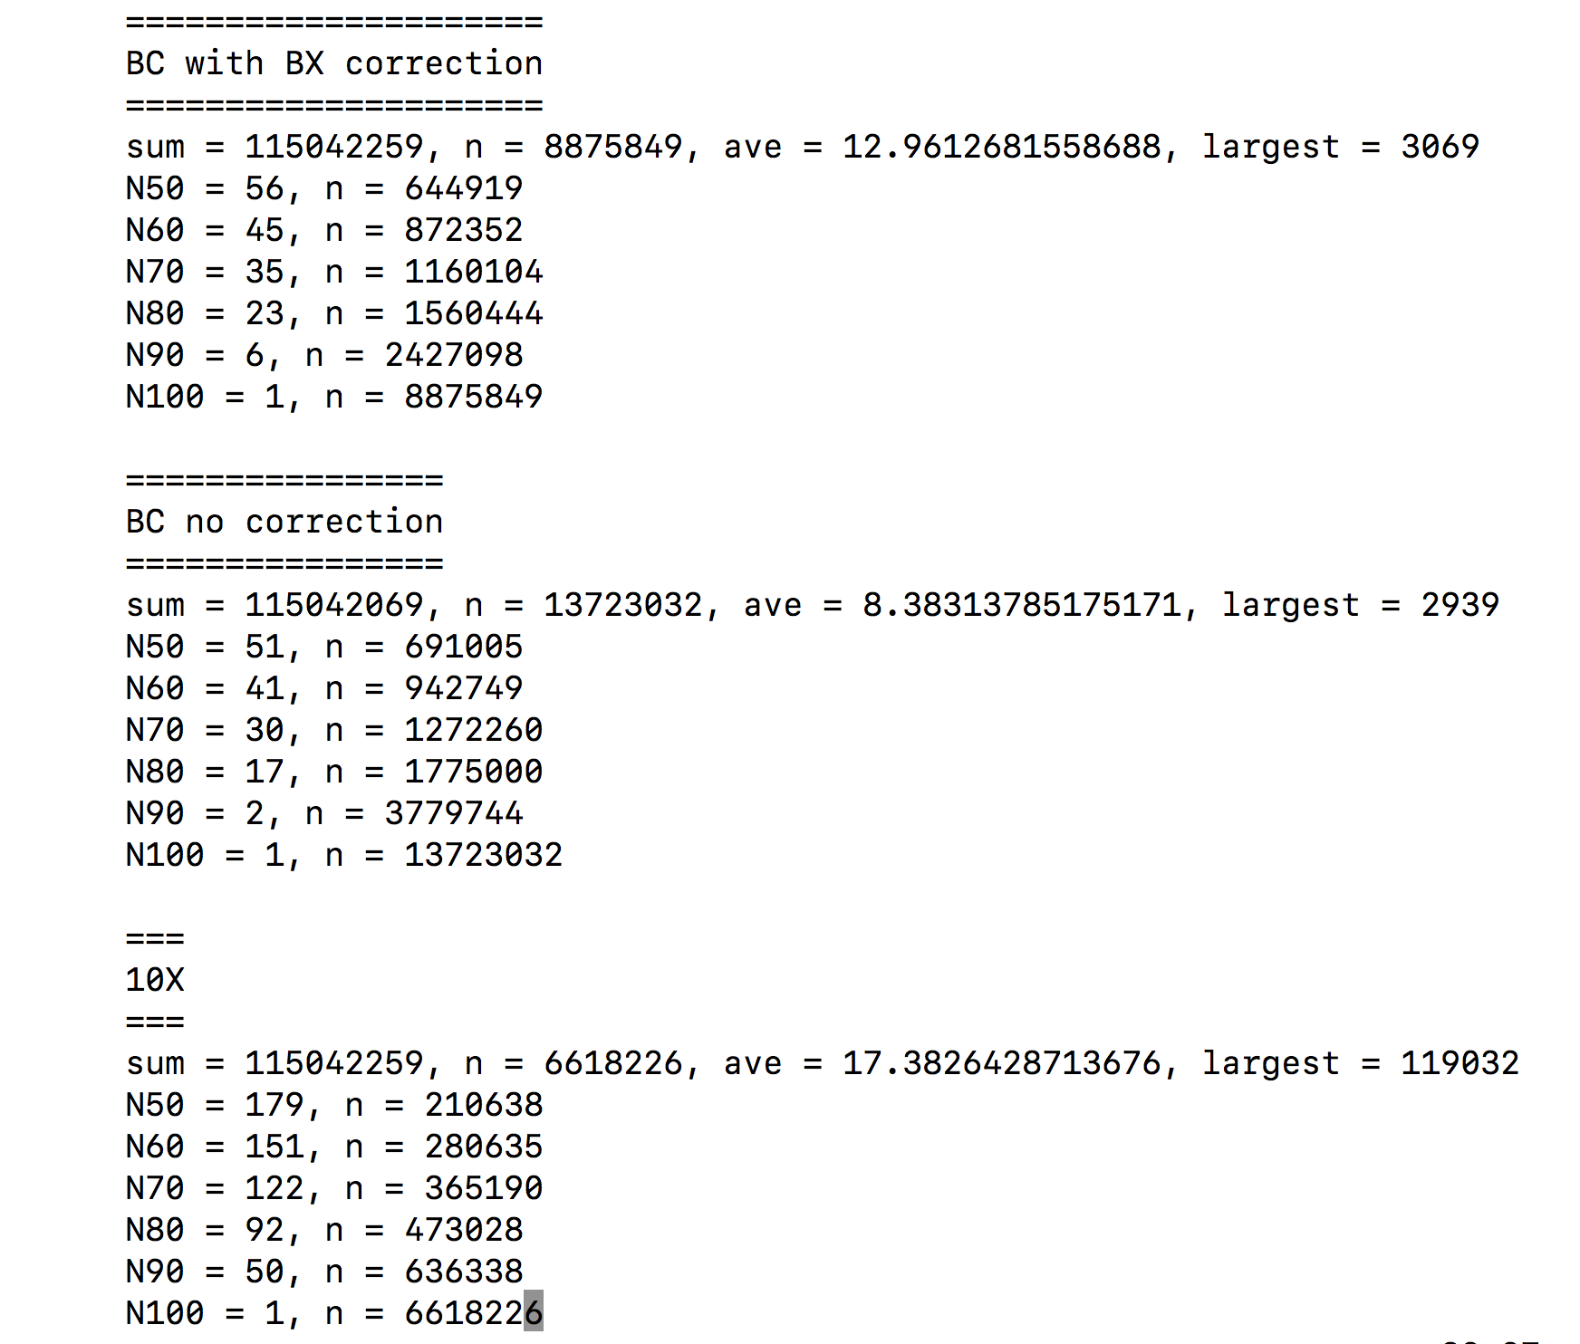
Number of Reads per Barcode
ilAutGamm1

Slide 11
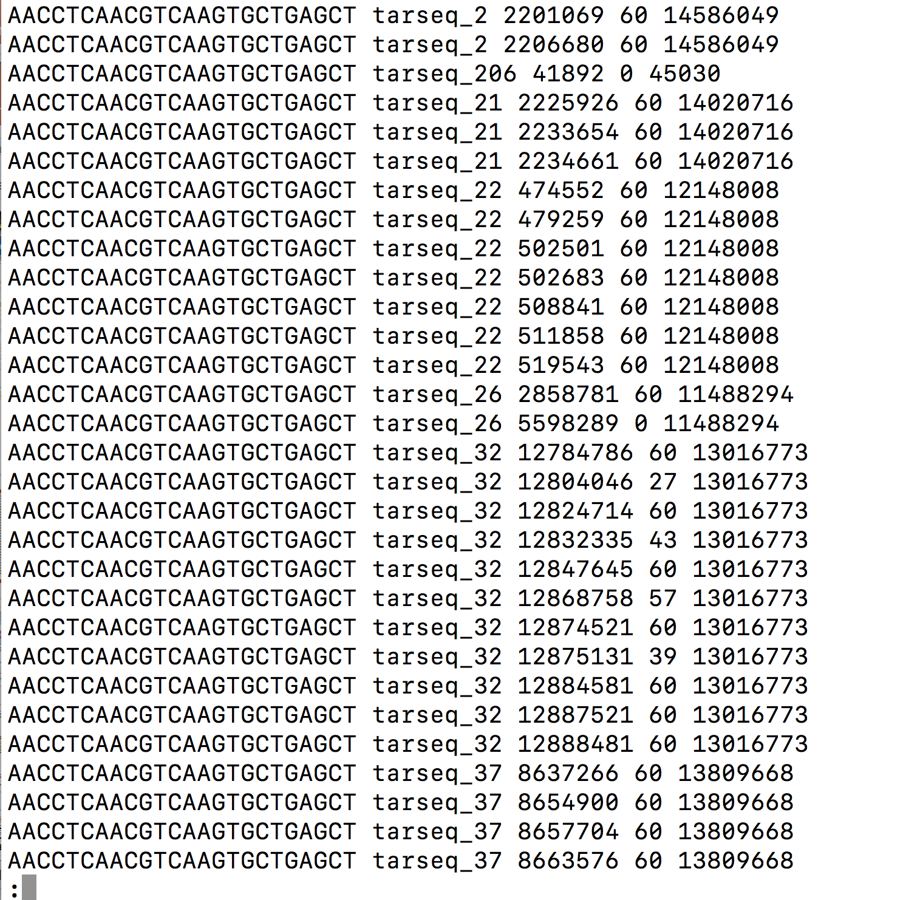

Slide 12
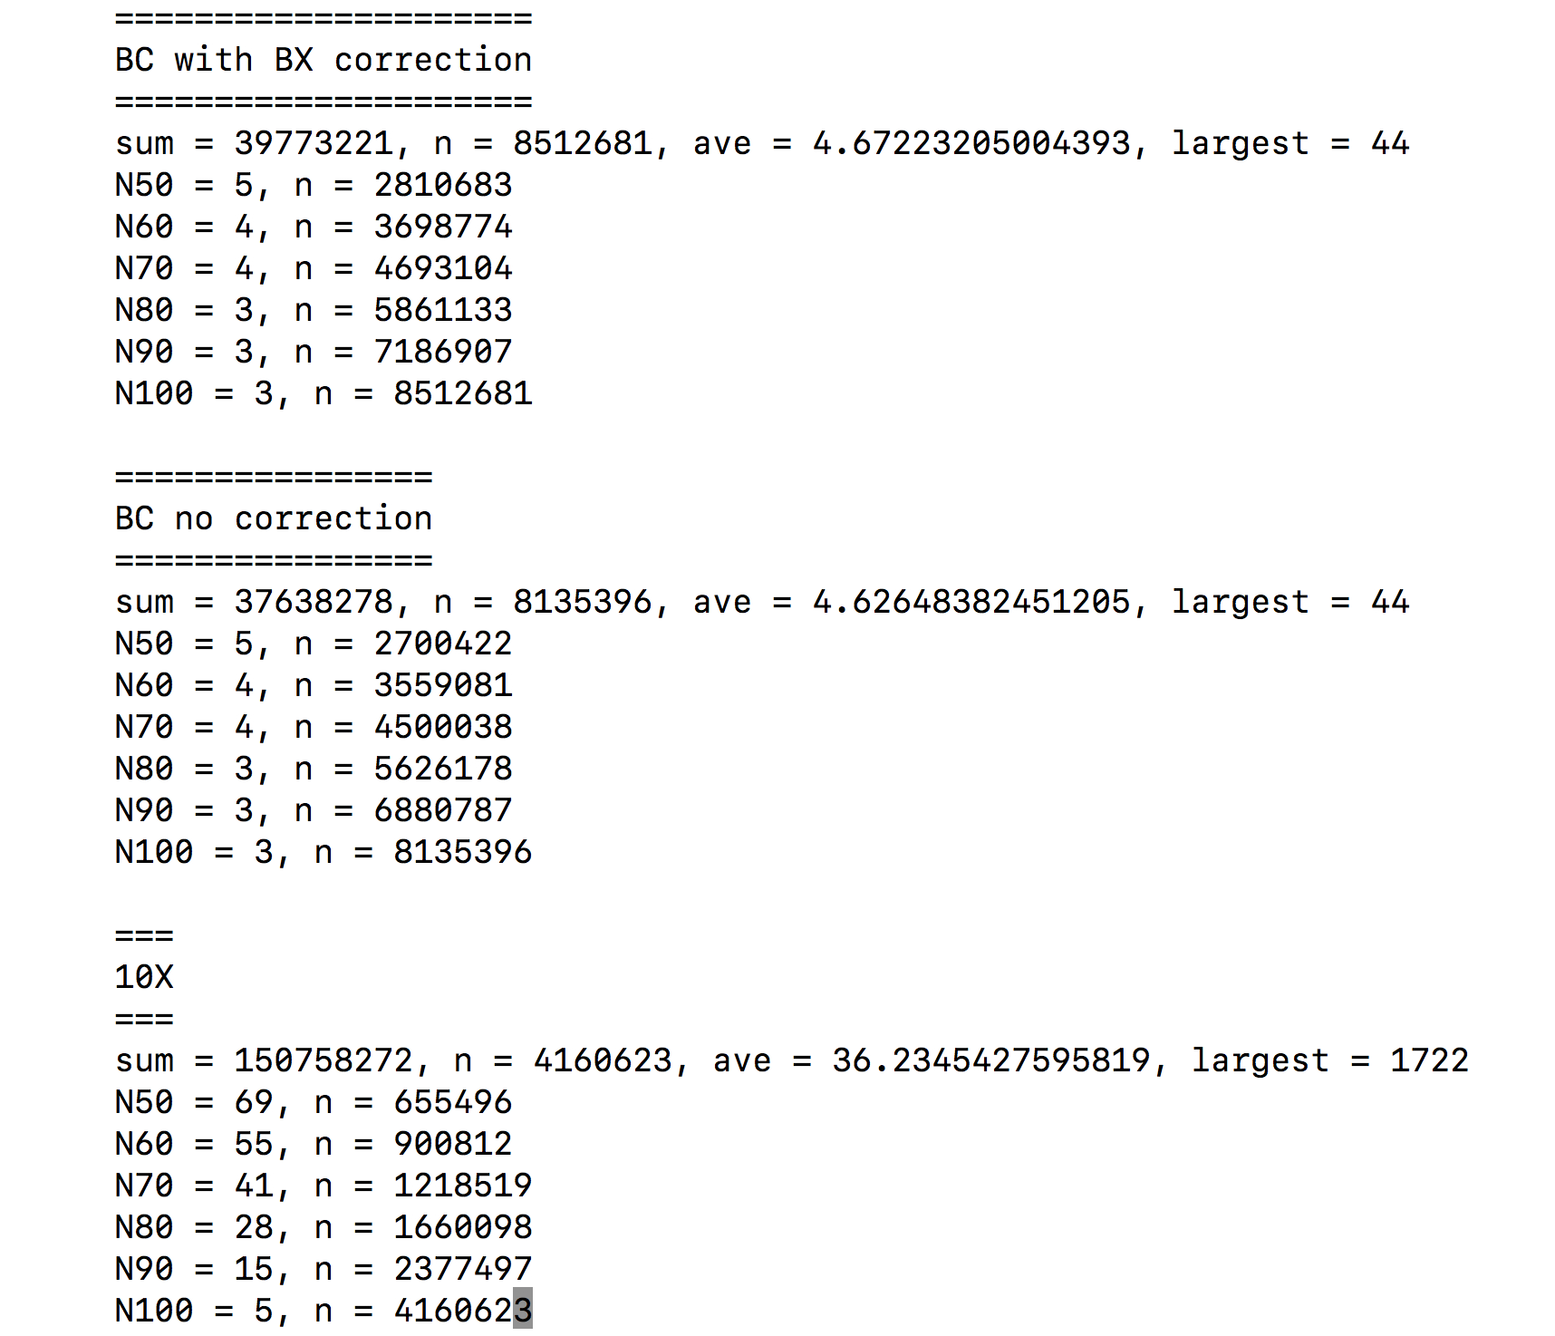
Number of Reads /Barcode Fragment
ilAutGamm1

Slide 13
Barcode Fragments and Coverage
with 95 Million Reads
 | Sanger-htag | Marek-htag | 10X
Num_barcodes | 7123535 | 2610242 | 2212882
Barcode Coverage | 412 | 87 | 140
Ave length | 38687 | 22353 | 43033
N50 | 51994 | 28938 | 58148
N60 | 45060 | 24960 | 49212
N70 | 38183 | 21149 | 40698
N80 | 30856 | 17210 | 32204
N90 | 22122 | 12592 | 22957
N100 | 2 | 2 | 4

Slide 14
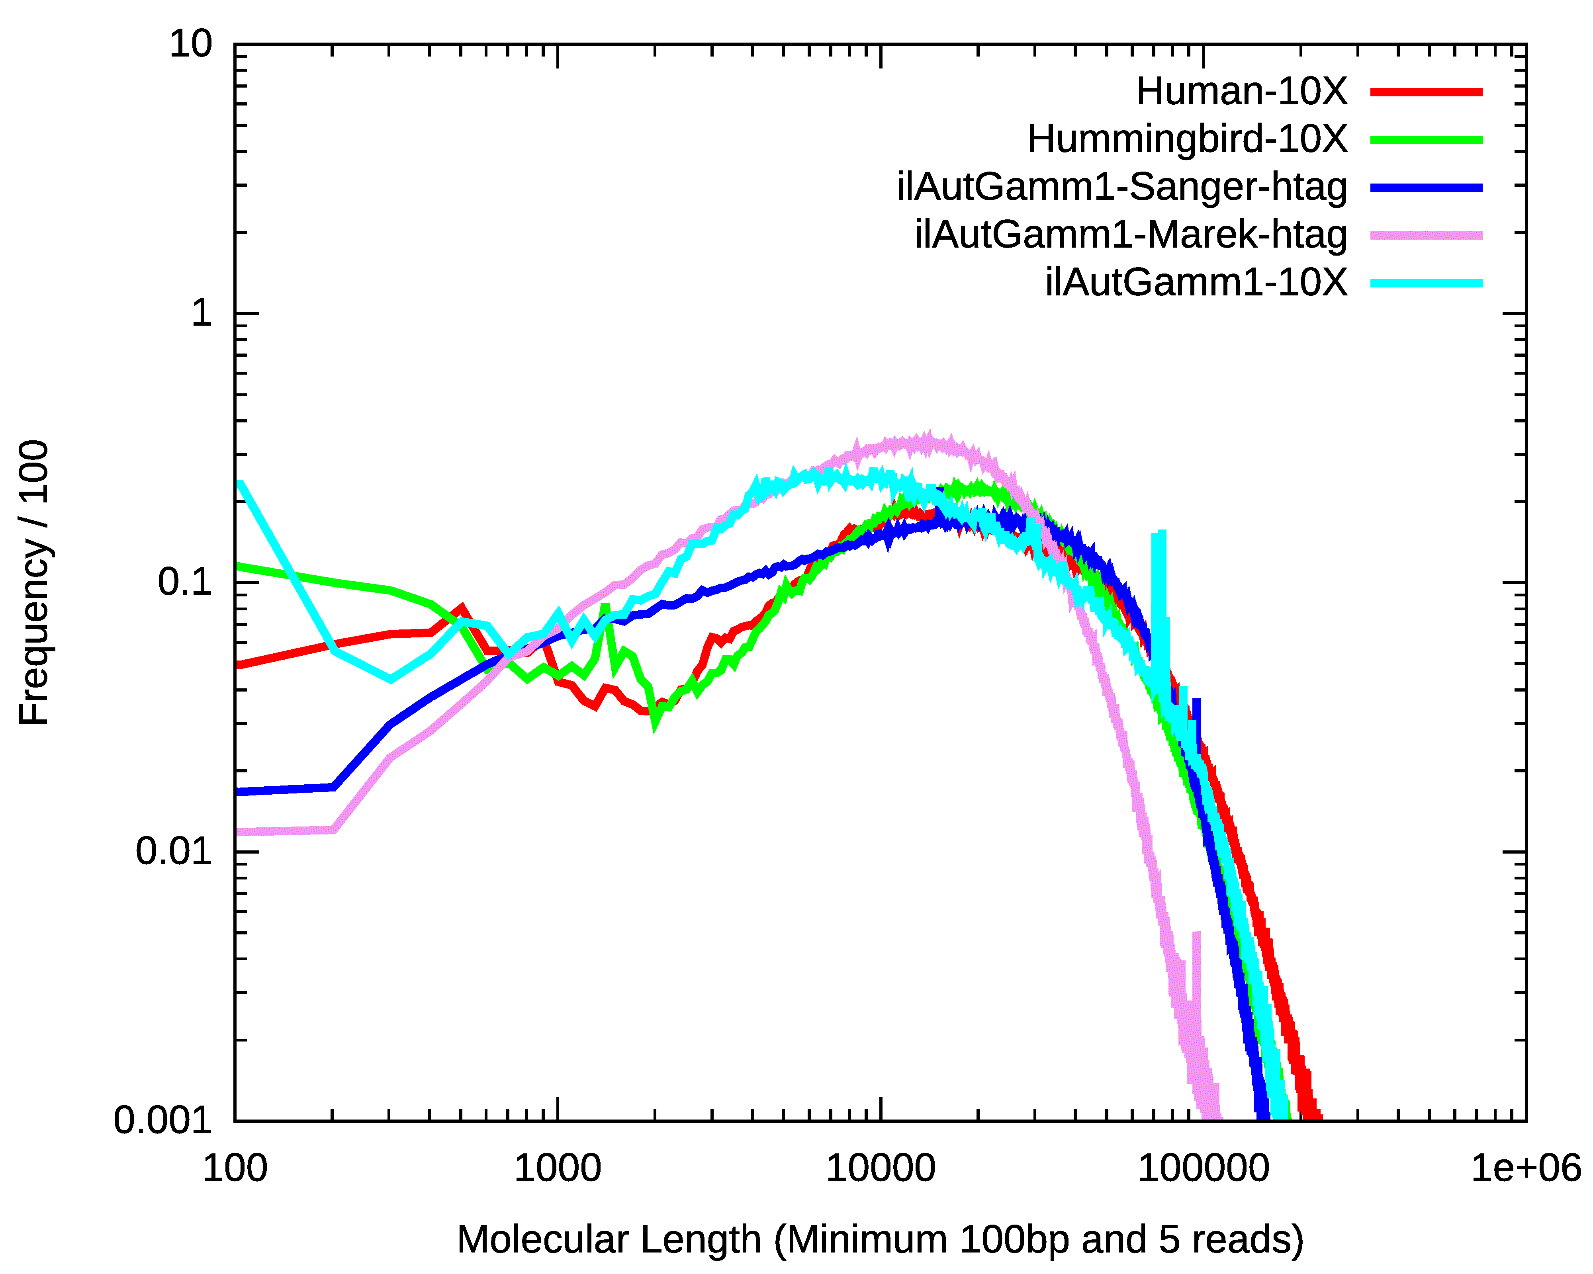
 | Sanger-htag | Marek-htag | 10X
Ave | 38632 | 22353 | 36086
N50 | 51946 | 28938 | 56638
N60 | 45017 | 24960 | 46776
N70 | 38139 | 21149 | 37437
N80 | 30818 | 17210 | 28487
N90 | 22078 | 12592 | 18493
N100 | 2 | 2 | 4

Slide 15
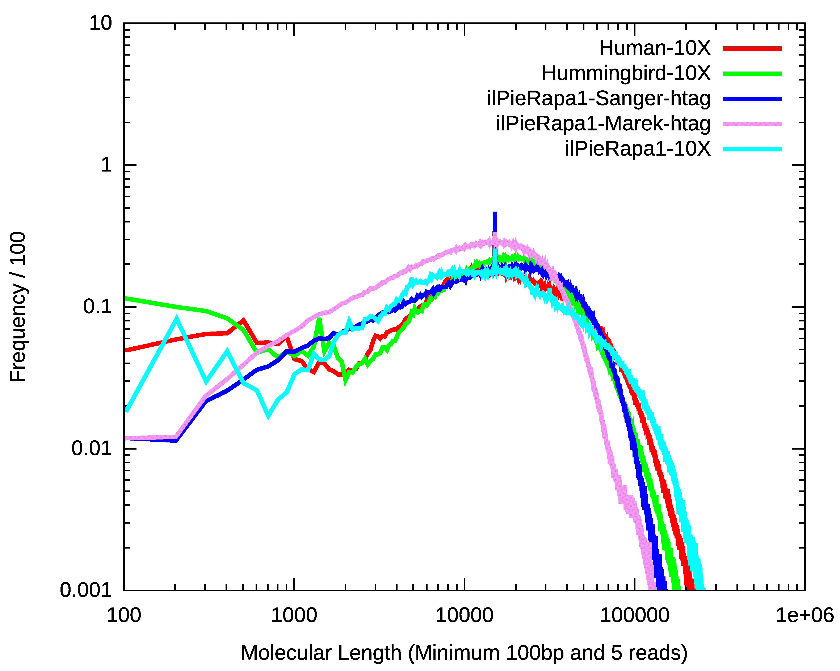
 | Sanger-htag | Marek-htag | 10X
Ave | 36082 | 25163 | 49860
N50 | 47753 | 32431 | 78671
N60 | 41378 | 28144 | 64780
N70 | 35084 | 23957 | 51469
N80 | 28414 | 19549 | 38446
N90 | 20448 | 14291 | 24542
N100 | 2 | 2 | 4

Slide 16
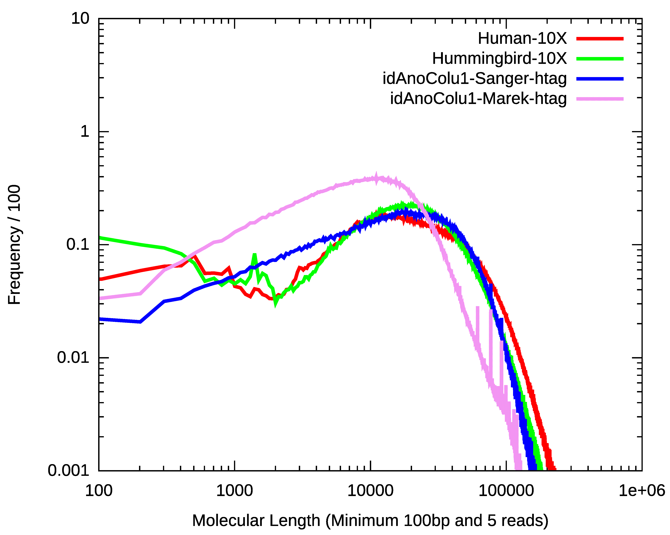
 | Sanger-htag | Marek-htag
Ave | 36729 | 19875
N50 | 48542 | 25982
N60 | 41995 | 22036
N70 | 35606 | 18459
N80 | 28882 | 14946
N90 | 20768 | 10833
N100 | 2 | 2

Slide 17
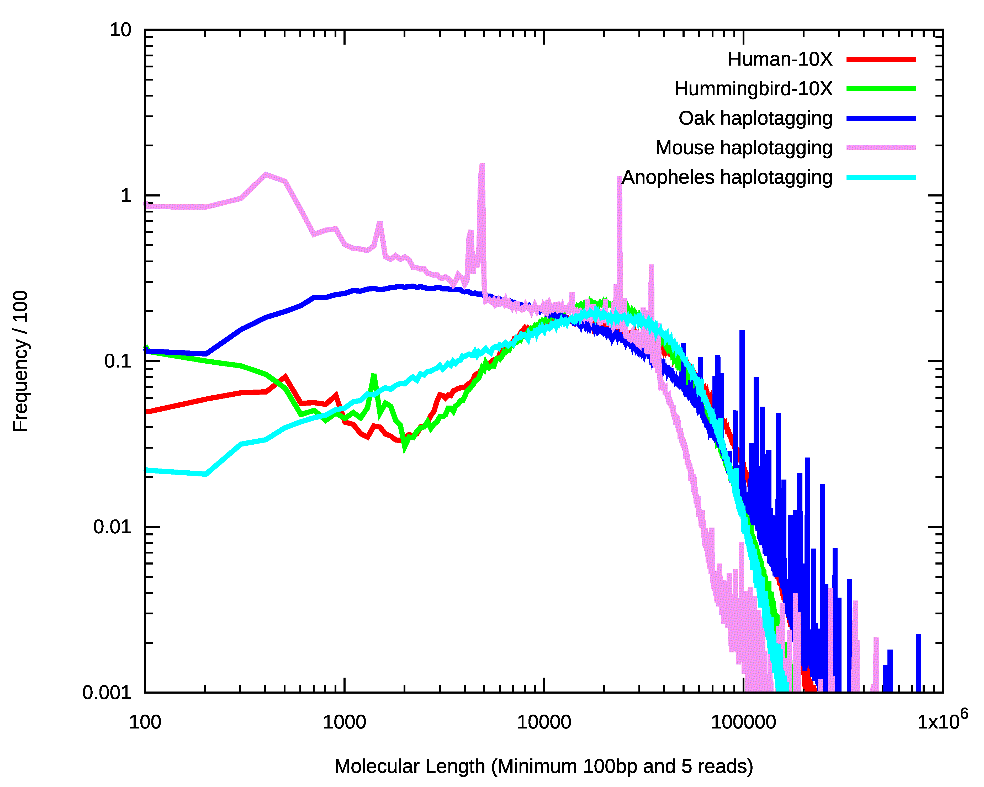
 | Oak | Mouse | Anopheles
AVE | 42116 | 18923 | 36729
N50 | 72311 | 31675 | 48542
N60 | 57688 | 26943 | 4195
N70 | 45347 | 23339 | 35606
N80 | 33848 | 18380 | 28882
N90 | 21687 | 12091 | 20768
Oak, Mouse and Anopheles

Slide 18
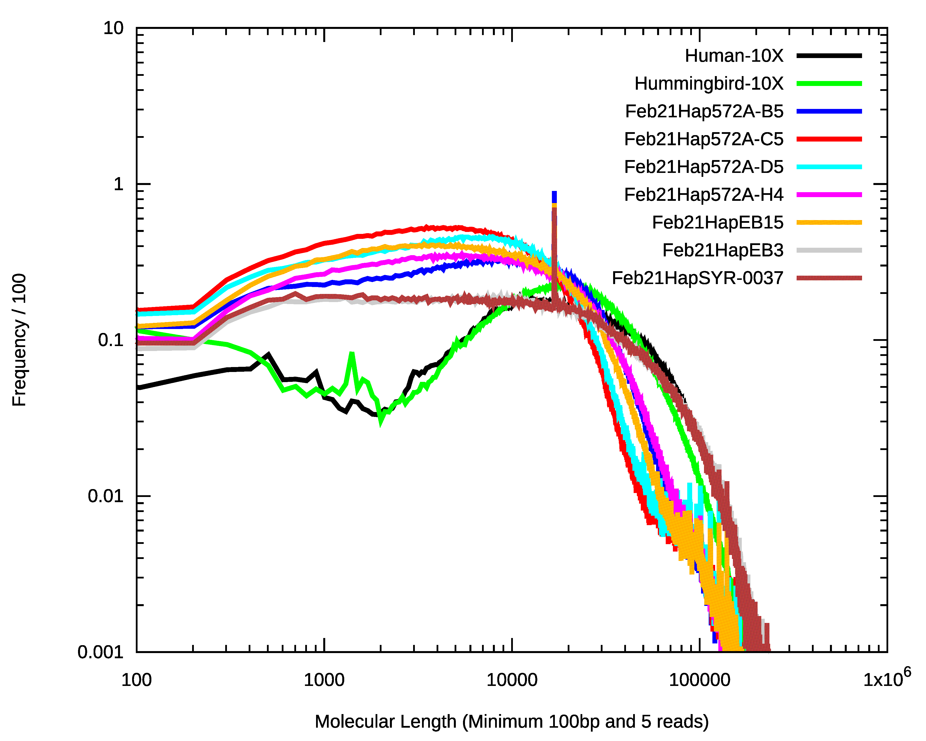
 | Ave | N50 | N80 | N90
Feb21Hap572A_B5 | 21677 | 29826 | 16832 | 11781
Feb21Hap572A_C5 | 16056 | 22987 | 11763 | 8010
Feb21Hap572A_D5 | 17621 | 24488 | 12969 | 8996
Feb21Hap572A_H4 | 21759 | 31735 | 16834 | 11507
Feb21HapEB15 | 19520 | 28252 | 15065 | 10175
Feb21HapEB3 | 42157 | 67762 | 33793 | 22267
Feb21HapSYR-0037 | 40942 | 64674 | 32786 | 21778
Hoverfly

Slide 19
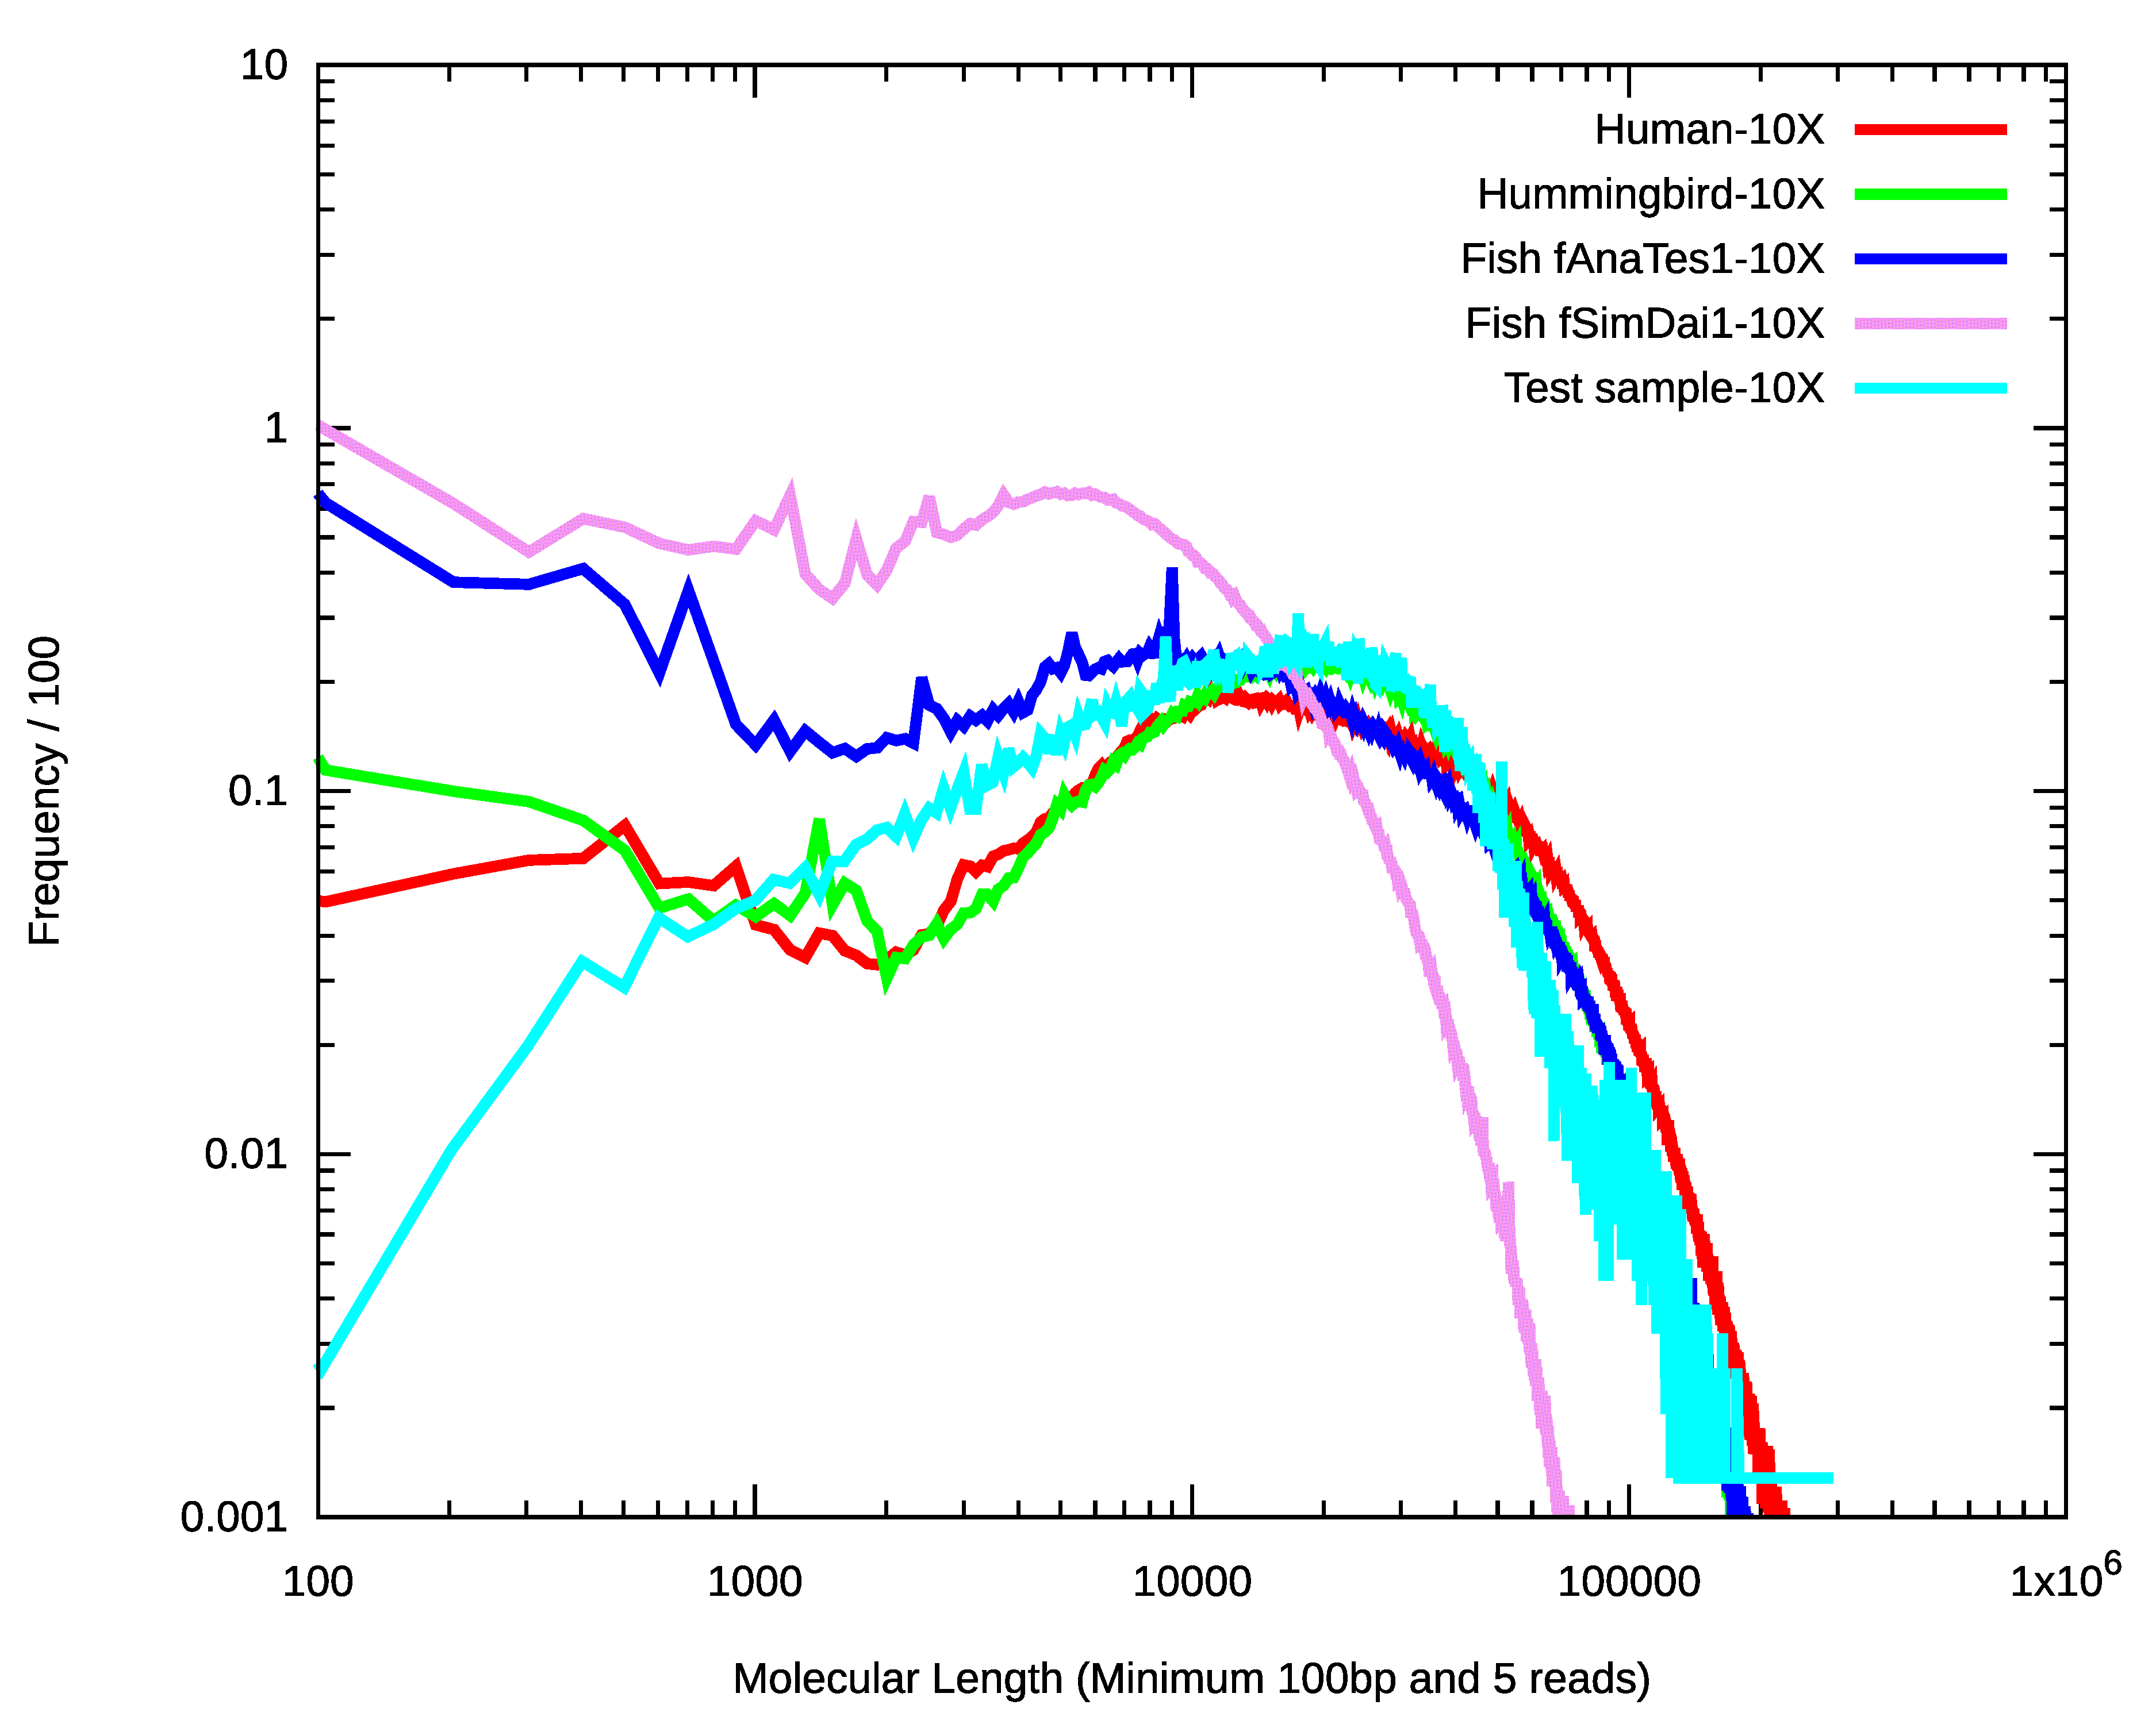
 | Ave | N50 | N80 | N90
gsMetZobel | 31244 | 39727 | 23703 | 17346
Marine Yeast

Slide 20
PCR Duplications
 | Paired Reads | Duplicated Pairs | Rate (%)
Mouse | 479100881 | 357589804 | 74.6376845
Oak | 349001678 | 156122357 | 44.7339846
Anopheles | 111520076 | 24627790 | 22.0837278
Feb21Hap572A_B5 | 70590126 | 26263423 | 37.2055194
Feb21Hap572A_C5 | 70794382 | 24961263 | 35.258819
Feb21Hap572A_D5 | 59616600 | 18804196 | 31.5418793
Feb21Hap572A_H4 | 61797720 | 19435780 | 31.4506425
Feb21HapEB15 | 63206646 | 22379926 | 35.4075519
Feb21HapEB3 | 58974132 | 18035434 | 30.5819406
Feb21HapSYR-0037 | 50559306 | 16862322 | 33.3515693
gsMetZobel | 4249272 | 503894 | 11.8583607

Slide 21
Hoverfly – Genome Scaffolding
 | N_scaffolds | N50 | N90 | Max_scaffolds
idEpiBalt1-purged | 260 | 5.09 | 1.31 | 16.8
Feb21Hap572A_B5 | 126 | 20.2 | 4.06 | 56.4
Feb21Hap572A_C5 | 166 | 8.62 | 2.98 | 23
Feb21Hap572A_D5 | 204 | 6.32 | 2.04 | 20.4
Feb21Hap572A_H4 | 138 | 16.1 | 3.31 | 41
Feb21HapEB15 | 134 | 17.6 | 3.75 | 34.8
Feb21HapEB3 | 109 | 20.2 | 4.43 | 56.9
Feb21HapSYR-0037 | 103 | 20.2 | 5.23 | 56.9

Slide 22
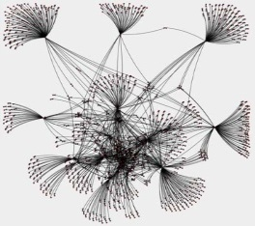
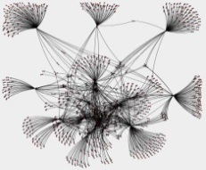
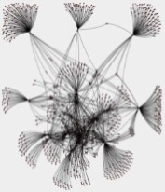

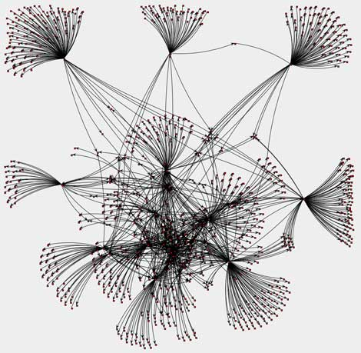
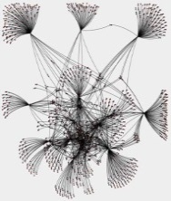

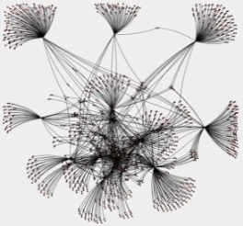
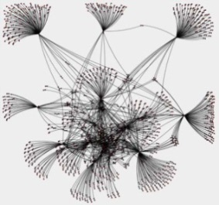

Strategy of Genome Scaffolding
Contigs connected by shared barcodes
Break connections by increasing shared barcodes
Assembly Scaffolds
Contig Order & Orientation

Slide 23
Genome Scaffolding
 |  | ASM | Sanger-htag | Marek-htag | 10X
ilAutGamm1 | N_scaffs | 242 | 217 | 242 | 216
 | Ave | 2.70Mb | 3.00Mb | 2.70Mb | 3.02Mb
 | N50 | 11.99Mb | 12.15Mb | 11.99Mb | 12.05Mb
 | N90 | 4.97Mb | 6.57Mb | 4.97Mb | 6.82Mb
 | Max | 15.31Mb | 23.32Mb | 15.31Mb | 22.68Mb
ilPieRapa1 | N_scaffs | 121 | 120 | 121 | 116
 | Ave | 2.17Mb | 2.18Mb | 2.17MB | 2.26MB
 | N50 | 10.66Mb | 10.66MB | 10.66Mb | 10.66Mb
 | N90 | 6.77Mb | 7.14Mb | 6.77Mb | 7.80Mb
 | Max | 12.90Mb | 12.90Mb | 12.90Mb | 12.90Mb
idAnoColu1 | N_scaffs | 1035 | 912 | 835
 | Ave | 0.33Mb | 0.37Mb | 0.41Mb
 | N50 | 2.63Mb | 5.22Mb | 4.67Mb
 | N90 | 0.14Mb | 0.16M | 0.19Mb
 | Max | 11.91Mb | 15.54Mb | 16.95Mb

Slide 24
Summary
Base level quality of Haplotype tagging is better that of 10X
Evenness of read coverage is good
Barcode length is slightly shorter, but comparable
Density of reads per barcode is notably lower than that of 10X
Reasonable results obtained on genome scaffolding
Barcode differences in 12 libraries to be assessed
Suitability for breakpoint analysis needs to be evaluated

Slide 25
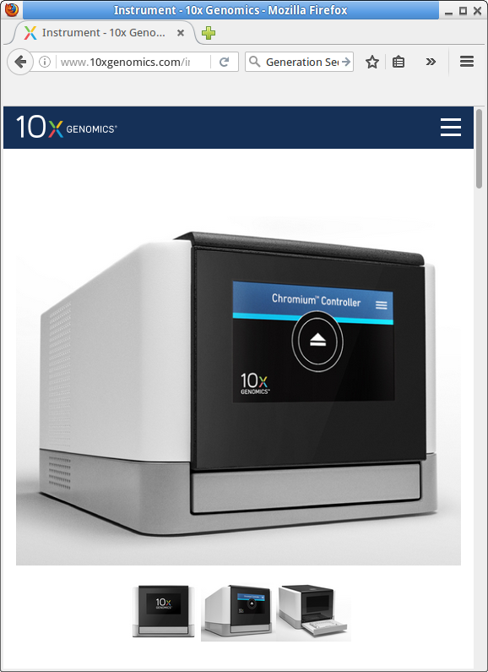
Acknowledgements:
Mike Quail
Shane McCarthy
Marek Kucka
Frank Chan
Mara Lawniczak

